Slide 1
AI Medical Report Simplifier for Patients
Turning confusing medical jargon into plain language and better questions for the doctor
Notes:
Introduce the idea: an AI tool that helps patients understand their medical reports. This version includes screenshots of the working prototype and measured results.

Slide 2
Patients struggle to understand reports
1 REAL-WORLD PROBLEM
Dense jargon
Anxiety & confusion
Short consultations
Terms like "hypertrophy", "idiopathic" or "bilateral infiltrates" mean little to non-experts.
Reports are often read alone, before any explanation. Patients fear the worst or miss what matters.
Doctors have limited time, so patients forget or hesitate to ask questions.
Result: poor understanding, weaker follow-through on treatment, and missed communication.
Notes:
Frame the problem from the patient's point of view.

Slide 3
Why does this gap exist?
2 ROOT CAUSE
Written for professionals
Low health literacy
Reports are made for clinicians, not for the people they describe.
Many people lack the medical vocabulary to interpret results.
No simple tools
Time-pressured care
Searching terms online gives scattered, sometimes unreliable or alarming answers.
There is little room in a visit to explain every term in detail.
Notes:
Root causes: communication style, literacy, tool gap, time.

Slide 4
Upload a report. Get clarity.
3 AI SOLUTION
1
2
3
4
Paste report
Detect terms
Explain simply
Suggest questions
Patient pastes or types the report text
Finds difficult terms and lab values
Explains each term in everyday language
Lists questions to ask the doctor
Expected outcome: better understanding of medical information and better patient–doctor communication.
Notes:
Walk through the four-step flow: paste, detect, explain, suggest questions.

Slide 5
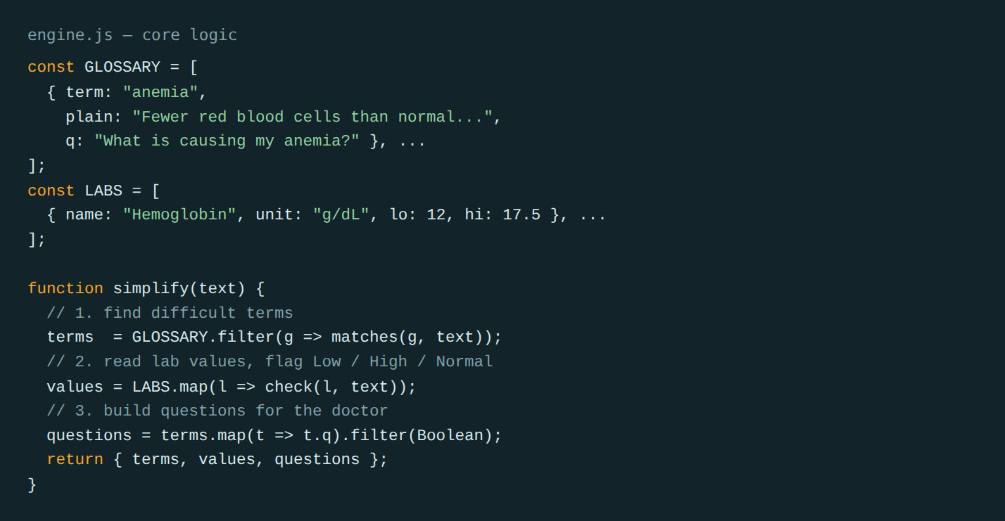
How we built the website
4 HOW WE BUILT IT
1
Plan the flow
Four panels: report, terms, lab values, doctor questions.
2
Build the glossary
20 medical terms, each with a plain-language meaning and a doctor question.
3
Add lab-value rules
Reads Hemoglobin, LDL, glucose and creatinine; flags Low / High / Normal.
4
Design the page
One HTML page (HTML + CSS + JavaScript). Runs in the browser, nothing is stored.
Screenshot: core logic in engine.js — find terms, check lab values, build questions.
Next version: swap the fixed glossary for an LLM API call with a "plain language, no diagnosis" prompt.
Notes:
Explain the build in four steps. The prototype uses a rule-based glossary so it runs offline; the planned upgrade is an LLM API with a safety prompt.

Slide 6
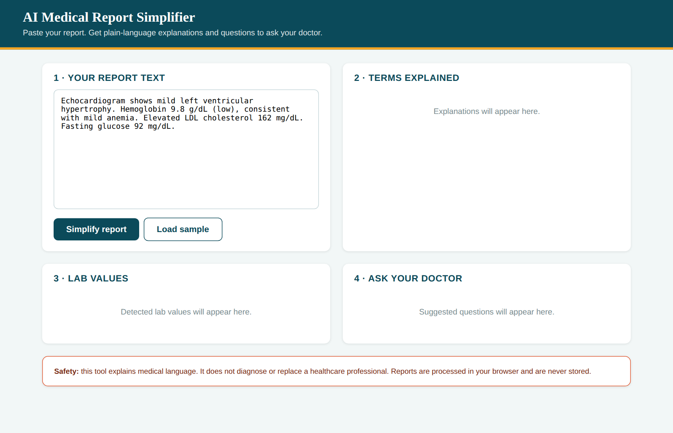
Step 1: the patient pastes a report
5 THE WEBSITE
Input
Text box + "Load sample" button for a quick demo.
One click
"Simplify report" runs the analysis instantly.
Privacy
Runs in the browser. Nothing is uploaded or stored.
Notes:
Show the empty-state page: header, text box, Load sample and Simplify buttons.

Slide 7
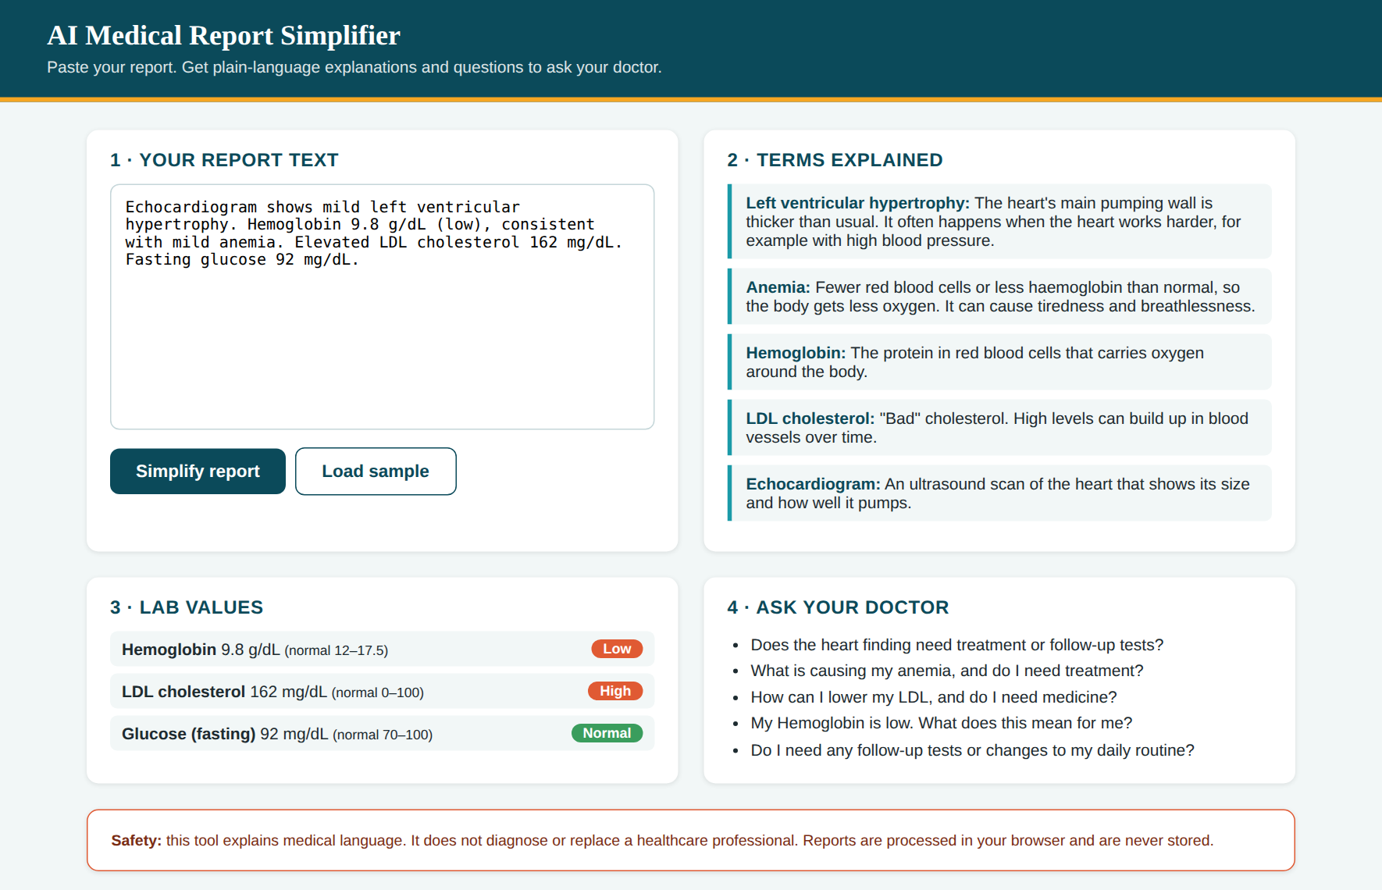
Step 2: plain-language results
5 THE WEBSITE
Terms explained
Each difficult term gets a one-line everyday meaning.
Lab values flagged
Hemoglobin 9.8 = Low, LDL 162 = High, glucose 92 = Normal.
Ask your doctor
Five questions generated from the report.
Safety banner stays visible: explains, never diagnoses.
Notes:
Demo: click Load sample then Simplify. Walk through the four panels and the safety note.

Slide 8
Results: reports became much easier to read
6 RESULTS
11.4 → 4.3
16
Average reading grade
Medical terms explained
4
17
Abnormal lab values flagged
Doctor questions generated
Tested on 3 synthetic sample reports (cardiac, chest scan, blood panel). Readability = Flesch-Kincaid grade of the original text vs the explanations. Not clinically validated.
Notes:
Results come from running three synthetic reports through the prototype. Average reading level fell from about grade 11 to about grade 4. Be clear that this is a small test and not a clinical validation.

Slide 9
What's next: accuracy and safety
7 LIMITS & NEXT STEPS
Next steps
Current limits
Have a doctor or medical student review every explanation
Replace the fixed glossary with an LLM API and a "plain language, no diagnosis" prompt
Run a user study: do patients understand more than before?
Support PDF upload and more languages
Only 20 terms and 4 lab tests are covered
Reference ranges are general, not personalised by age or sex
Tested on synthetic reports only
Text input only, no scanned images
Safety: the tool explains, it does not diagnose. Always confirm with a healthcare professional and protect patient privacy.
Notes:
Stress safety: no diagnosis, no replacement for doctors. Be upfront about the limits of the prototype.

Slide 10
Better understanding.
Better conversations.
Thank you. Questions?
Notes:
Close and invite questions.

